Slide 1
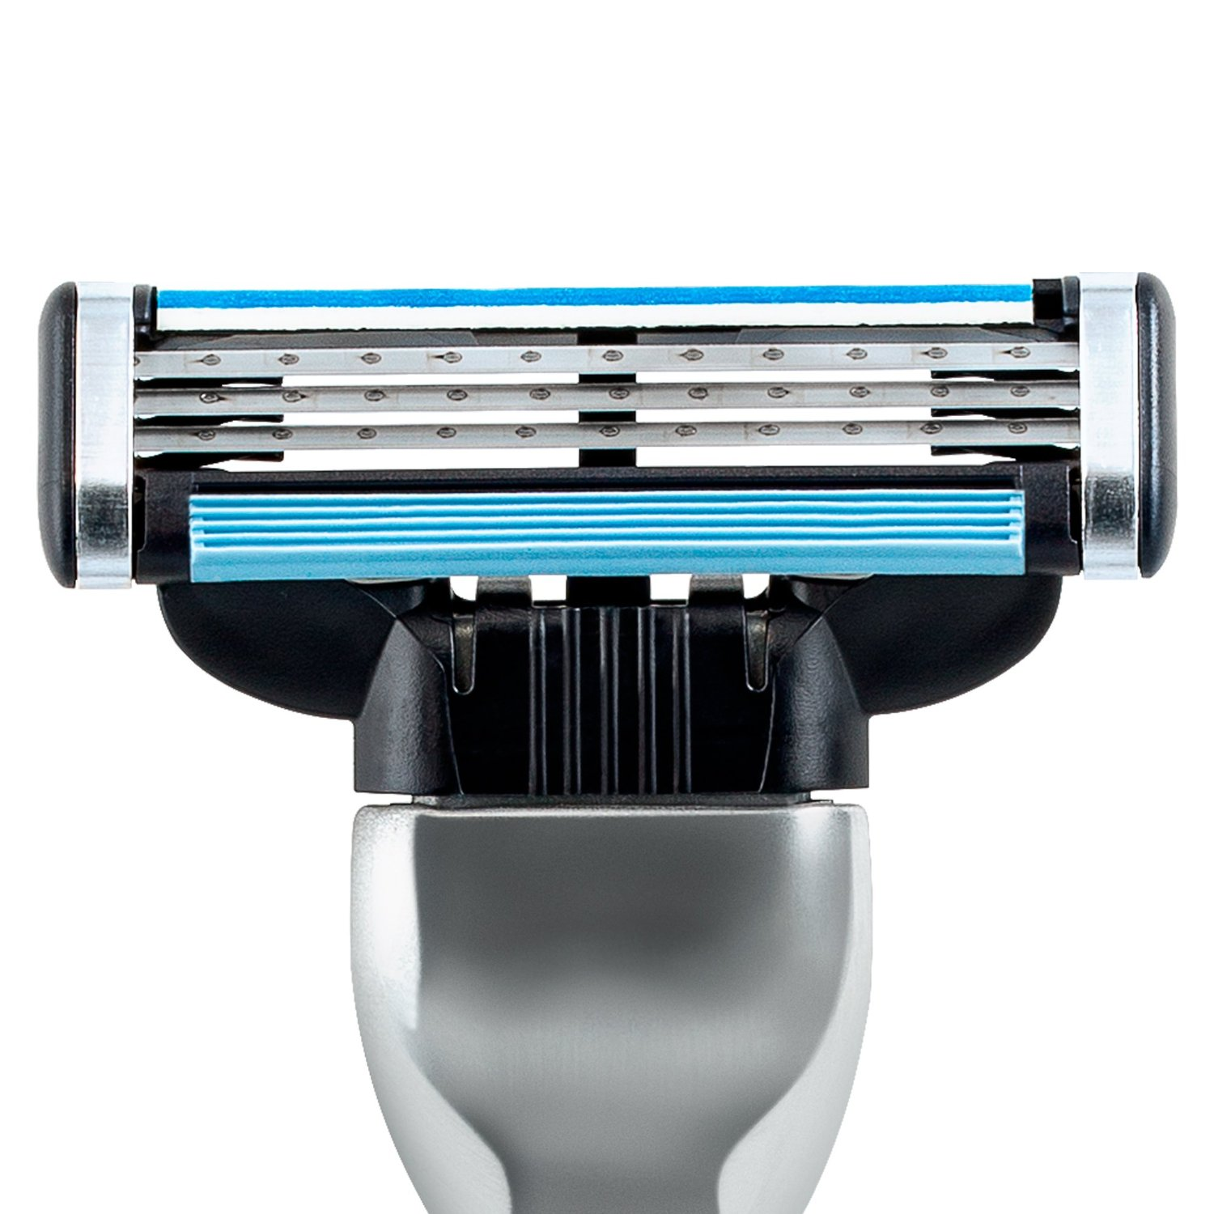
Gillette vs. Energizer Progressive Blade Geometry Patent Infringement
Section 2 Team 2
Jonathan Hudgins, Vishal Bajaj, Neal Doshi, Joshua Jenkins, Lora Neel, Mathew Simmons

Slide 2
Table of Contents
Expected Payoff of Options
Summary Decision Tree
Sensitivity Analysis
Value of Information
Utility Theory
Zone of Potential Agreement
Recommendation Rationale: Additional Considerations

Slide 3
To Litigate or Settle?
Given current probabilities and values, the recommendation is to Litigate.
 | Litigate | Settle
Cost | ($6,500,000) | $0
Expected Payoff | $12,377,710 | $4,500,000
Net Expected Payoff | $5,877,710 | $4,500,000
Litigate yields an additional $1,377,710, which is about 30% more than settling the case.

Slide 4
Summary Decision Tree

Slide 5
Sensitivity Analysis
Establish Baseline
Change Inputs
Decision Impact
Decision Tree with case facts
Change probabilities and dollar amounts using data tables
Observe thresholds that change the decision from Litigate to Settle
Areas that impacted decision
Mr. Gilder testifying
The Jury
Patent Validity
Patent Infringement
Jury buys Gillette’s argument or Energizer’s
The Judge: Damage Awards
Business Impact: Hiatus from competition
Notes:
Each uncertain input to our decision model will have a possibly different effect on the overall outcome of the case. Some key uncertainties in this case are the jury, the judge and potential business impacts. More specifically, the trial itself presents a number of uncertainties and variability's to contend with: jurisdiction, judge, precedent, the opposition’s legal team and their experience with patent law, possible patterns of previous similar cases, witness testimony and particularly the decisions of an uninvolved 12 person jury. We cannot ignore the fact that the strongest evidence and argument may not be enough to persuade 12 members of the general public, particularly if they hold on to the idea of Gillette as a monopoly given our already 70% market share of the American razor market compared to Schick’s 13%.
An effective sensitivity analysis lends credence to the fact that our assigned probabilities are merely a “best guest” based on the value of information given. Perfect information in this case is impossible. If we had it, case closed. Because we don’t, we make our best judgments then utilize sensitivity analysis and focus our value of information to test other possibilities and gain a broader understanding of the collective outcomes.

Slide 6
Sensitivity Analysis
The expected payoffs of the decision tree analysis indicate that the optimal decision is to Litigate. In order to understand when uncertainties would change the decision, we conducted a sensitivity analysis. The parameters below illustrate the thresholds when the decision would change from Litigate to Settle.
Litigate
Settle
Sensitivity Adjustments
Current Recommendation
Adjusted Recommendation
Current Value: Litigate
Adjusted Threshold: Settle
Absolute Difference
Patent Validity
53.75%
<51.5%
- 2.25%
Patent Infringement
50.5%
<=47%
- 3.5%
Impact of Loss of Patent
($20,000,000)
($23,000,000)
$3,000,000
Impact of patent not infringed
$5,200,000
($8,000,000)
($13,200,000)
2-Year Hiatus
30%
<= 15%
- 15%
Mr. Gilder Testifies
50%
100%
50%
Notes:
The slide is an overview of how sensitive our decision to litigate is at each step of the the decision tree. The values shown are for the overall macro tree. However, there is more analysis to be accomplished diving deeper into probabilities. For example, there are three components to the overall patent infringement probability and if any one changes, our overall patent infringement probability changes. It would be useful to know if the lawyers could increase their probability of convincing the jury of their “functions in substantially the same way argument.” If this probability falls to 46% (driving the overall probability to 47%) or lower, the decision changes to Settle.
The judge’s damages decision (40% chance damages are paid based on lost profits, 60% chance damages are paid based on royalties) did NOT effect our Settle vs. Litigate decision and had little effect on EV, therefore we chose to leave it out of the sensitivity analysis discussion, focusing more on the information could change a decision.
Additionally, whether the jury “buys Gillette’s or Energizer’s argument” probabilities did not change the decision to litigate or settle. Obviously, it would be preferred to have the jury buy Gillette’s argument.

Slide 7
Value of Information
Given the sensitivity analysis results, we determined the Value of Information of knowing the outcomes of certain events.
Event | Current Probability | Adjusted Probability | EVPI
Patent Infringement – DoE “functions in substantially the same way” argument | 50% | 100% | $26,671,220
Knowing Mr. Gilder will NOT Testify | 50% | 100% | $5,270,790
Knowing if the Patent is Valid | 50% | 100% | $10,175,000
Notes:
Patent infringement probabilities are less likely to change given the lawyer’s educated assessments of literal infringement and what they can and cannot prove given that Gillette’s patent specifically refers to a razor with three blades. Infringement probabilities under the DoE provide a more beneficial return on investment with respect to VOI and focusing efforts on additional information in order to update probabilities. If we could change the lawyer’s given 50% probability of convincing the jury that the two razors “function in substantially the same way” to say a 100% probability, our EV would increase from $5,877,710 to $26,671,220 an increase of $20,793,510. Put another way, if we gained more information that led to an increased lawyer probability from 50% to 100%, our value of this information would be equal to the increase in expected value of $26,671,220.
However, if the lawyers assessment probability of convincing the jury that the two razors “function in substantially the same way” falls from 50% to 46% or less, the decision now changes to Settlement.
If we were to focus our Value of Information efforts on key uncertainties, Patent Validity and Patent Infringement would be it. The greatest uncertainties lie within these key events of our decision tree. We need to gather more information to determine Mr. Gilder’s intentions. Gaining certainty that he will or will not testify will help solidify our decision to litigate or settle. For example, if we knew with 100% certainty that Mr. Gilder did NOT intend to testify, our expected value of litigation would increase from 5,877,710 to 11,148,500 which means the value of this information is 5,270,790. And the probability that our patent was found valid would increase from 53.75% to 62.5%. If we knew with 100% certainty that Mr. Gilder DOES intend to testify, our probability of the patent being found valid now changes to 45% and we are better off settling the case with Energizer.
It may be more prudent to prioritize gaining information on Mr. Gilder’s intentions as this information may be easier to obtain than an updated assessment from the legal team on their ability to convince the jury that the two razors “function in substantially the same way.” However, our EVPI for knowing if the jury will agree with the “functions in substantially the same way” argument is 5 times the value than knowing whether Mr. Gilder plans to testify.

Slide 8
Utility Theory
Estimated Risk Tolerance | Expected Utility | Recommendation
$9.5B (1/6 est.) | $5,765,900 | Litigate
Risks of litigation for Gillette are not material based on typical risk tolerance benchmarks
$26.5 million worse-case scenario is .046% of Gillette’s market value and 2.18% of Gillette’s annual razor budget
Risks of litigation are material to Schick/Energizer, given the business unit’s smaller razor budget.
Notes:
Since Gillette is valued at $57B, they have a high risk tolerance (estimated at 1/6th the value of the company). Also, they are publicly owned so the shareholders would want them to make the best absolute financial decision. Either way, the decision does not change the recommendation to go to court.

Slide 9
Opposition Analysis Schick’s Litigate or Settle Decision
Schick’s current settlement offer is well below expected losses from litigation, making a higher settlement offer likely
Schick’s estimated risk tolerance is approximately $55 million
Notes:
This decision tree depicts the expected value of litigation for Schick/Energizer. The model assumes that Schick’s legal fees are similar, and that they are getting similar counsel regarding probabilities and possible damage awards. The takeaway is that Schick has no upside to litigation, and that the expected value of Schick’s loss in litigation far exceeds its current settlement offer. The as-modeled expected value only includes legal fees and damages. It does not take into account lost profits that Schick would experience if they lose and have to stop selling the Quatro. If conservative estimates of lost profits are included, Schick’s expected losses increase to over $20 million. The precise expected loss of litigation is sensitive to a variety of probabilities and payouts, but it is much higher than the current settlement offer regardless.
Given Schick’s share of the razor market, we estimate its annual budget to be approximately $221 million, which equates to an estimated RT of approximately $55 million. Based on these estimates, risk tolerance is likely to be a factor for Schick, which leads to slightly lower certainty equivalents than expected values. Schick is likely willing to pay a slight premium to avoid higher risks. This factor becomes greater if lost profits are factored in.

Slide 10
Settlement - Zone of Potential Agreement
$5,877,710
Gillette
$20,720,00
Schick
*Assumes litigation. Schick’s worst-case scenario includes lost profits from continuing to sell the Quattro.
Possible ZOPA between $10 – $12 million
Notes:
Given Gillette’s expected value of litigation and Schick’s expected losses from litigation, we believe the zone of potential agreement for a settlement is somewhere between Gillette’s $5.8 and $20.7 million, with a likely reasonable settlement of $10-12 million.

Slide 11
Recommendation Rationale: Additional Considerations
Expected Payoff
Based on the analysis, Litigation yields the highest expected net payoff. $5,877,710 to litigate compared to $4,500,000 to settle.
Relative Settlement Amount
The settlement amount is immaterial when compared to Gillette’s $318,000,000 total revenue for Mach3 and Mach3 Turbo (1% of total).
Risk Tolerance
Gillette is more risk tolerant than Schick due to Gillette’s larger market value and revenue.
Market Statement
The decision to Litigate conveys a powerful message to the market. This could deter potential competitors from entering the market with similar products. Mid-size companies like Schick can absorb the litigation cost. However, litigation costs could bankrupt a startup (i.e. Dollar Shave Club).
Schick’s Expected Payoff
Schick’s downside is very high with no upside to Litigation and they have a strong incentive to settle. Understanding Schick’s decision tree analysis informs our decision and helps our team if we consider countering their settlement offer. Schick’s expected losses of litigation are much higher than current offer.

Slide 12
Questions?

